Slide 1
Mindfulness

Slide 2
What is mindfulness?
Mindfulness means paying full attention to something. It means slowing down to really notice what you're doing.
Our minds are busy places, and sometimes they can be full of thoughts and worries about things that have already happened, and things that might happen in the future.

Slide 3
What is mindfulness?
Mindfulness teaches us to focus on the present moment. We can do this in a number of ways, such as noticing our breathing, body scan meditations and journaling our feelings each day.
We have three mindful activities for you to try today, focusing on your senses.
Enjoy and let us know how you get on.

Slide 4
Lavender Playdough
Focusing your senses is a great mindful practice.
Here is a recipe for lavender playdough, but you can make any scented playdough that you like.
You could add glitter or lavender seeds if you like.
As you play with the playdough, notice how it feels in your hand, how it smells and how it makes you feel.
Follow this link for a video recipe for lavender playdough:
https://fb.watch/3mFNSmz4ES/
2 cups flour
1/2 cup salt
2 tbsp vegetable oil
2 tbsp cream of tartar
1 to 1.5 cups of boiling water (start with up to 1, mix it as below, then add a little more until it is just right)
1/2 tsp gel food colouring ( we use Wilton for intense colours)
a few drops of glycerine (my secret extra ingredient for extra smoothness and shine!)
A few drops of lavender essential oil
Mix the dry ingredients. Stir through the oil and essential oil. Add the boiling water and stir vigorously until all lumps are gone and it begins to come together. Then knead it until it stops being sticky. Add colouring and any flavouring/ natural scent at the kneading stage.

Slide 5
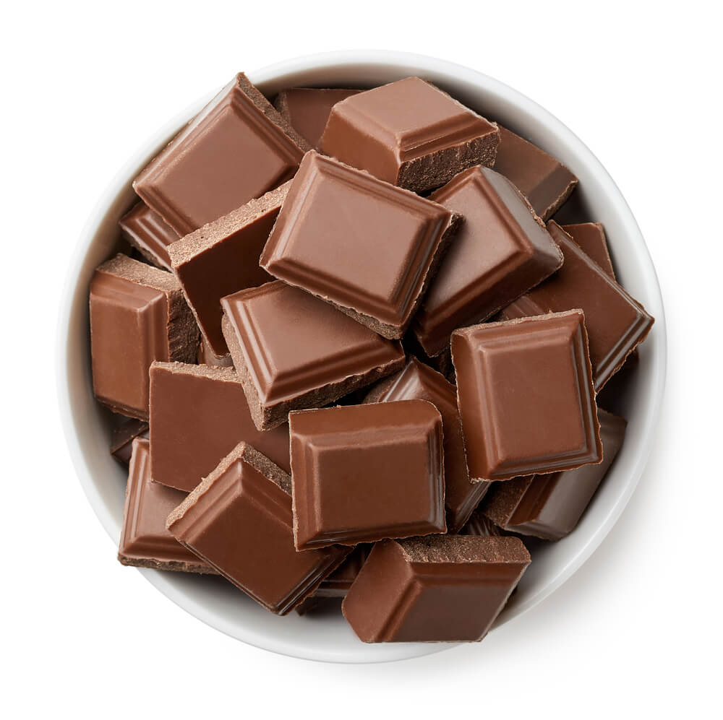
Chocolate
For this mindful activity you will need a small chocolate bar or some chocolate buttons.
Enjoy…

Slide 6
Chocolate
Consider the wrapped chocolate - Does the wrapper make a sound? What colour is it? What does it say? Where did it come from?
Open the chocolate, slowly - Do you feel a sense of anticipation, or an urge to immediately put the chocolate in your mouth? What physical sensations do you have? What emotions are you feeling? Just note them.
Look at the chocolate - Consider its texture, colour, weight…
Smell the chocolate - does the smell trigger any other senses? Where do you feel your sense of smell?
Place the chocolate in your mouth but DO NOT EAT!! How does it feel as it melts? Where in your mouth can you taste it? What is the consistency? What is happening with your mouth, teeth, tongue, lips as it melts? Move the chocolate around your mouth Does the area of taste change? Does the taste itself change? What is happening to the chocolate? How do you feel?
Swallow the chocolate, focusing on the sensation. Is there a lingering taste? How do you feel physically and emotionally? Take a little while to consider the experience.
How was this different from your general chocolate-eating experiences? More intense? Frustrating? More pleasurable? Were you more aware of your emotions during the exercise?

Slide 7
Mindful Walk
Challenge yourself to take a mindful walk
Whilst walking, see if you can be silent for 10 minutes. Could you manage longer?
Notice what you can see, hear, smell and feel.
See if you can collect 7 objects to represent the colours of the rainbow whilst on your walk:
Red, orange, yellow, green, blue, indigo, violet

Slide 8
Minfulness
We hope that you enjoy these mindful activities.
We’d love to see what you get up to, so please send us photos
Most importantly, remember to practise these mindful activities whenever you feel overwhelmed to help your busy brain settle.

