Slide 1
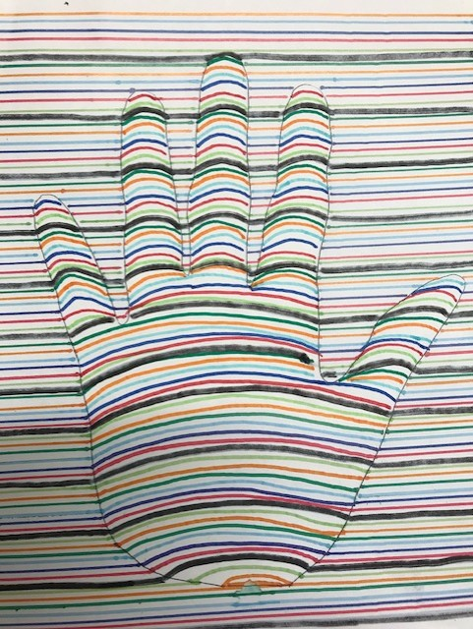
Children’s Mental Health Week 1-5th February 2021

Slide 2
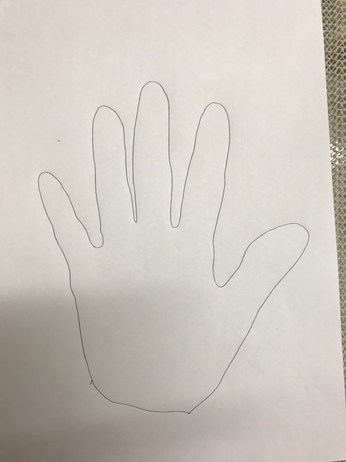
Draw around your hand.

Slide 3
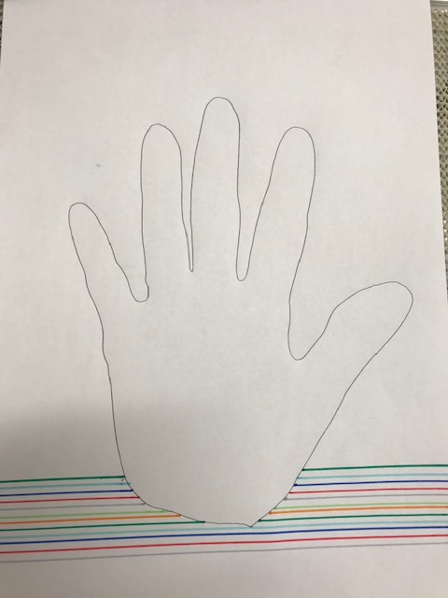
Choose some coloured felt tip pens and use a ruler to draw straight lines across the page but not inside the hand print

Slide 4
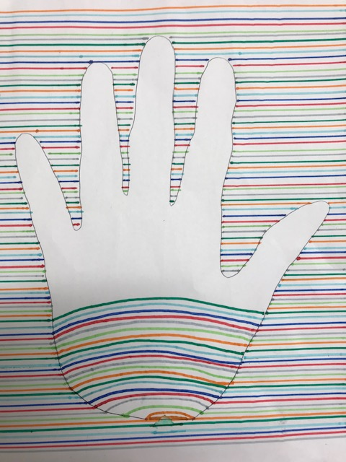
Once the page is filled, use the same colours to draw an arced line inside the handprint which matches up to the colours on both sides.

Slide 5
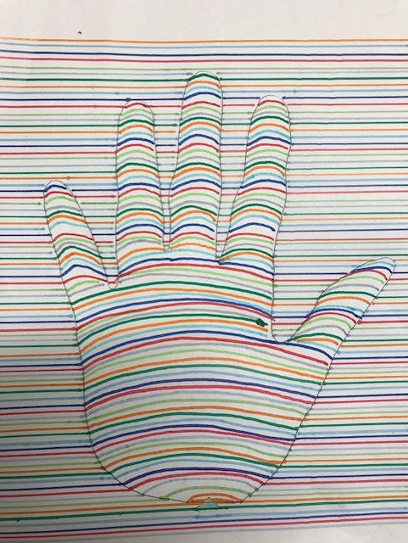
Continue all the bay up the hand, fingers and thumb until it is all filled.

Slide 6
Finally, use a black felt tip pen to go over one of the lighter colours all the way up the hand, fingers and thumb.
Your hand is unique- just like you.

